Slide 1
Touchless ordering system
Hoang Long Tran

Slide 2
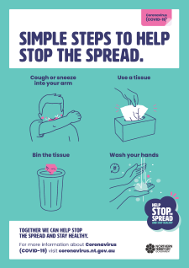
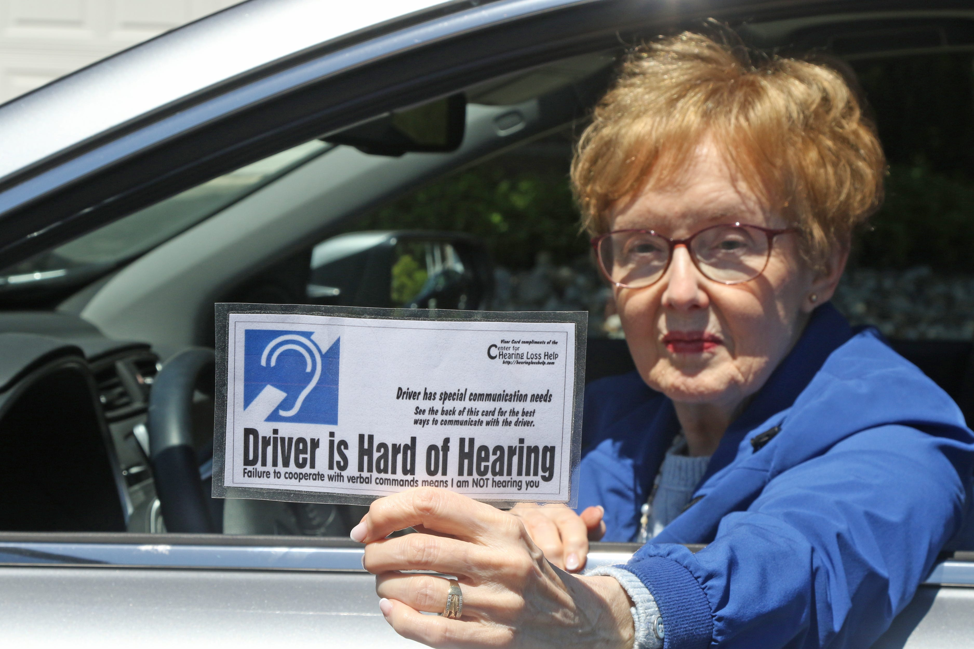
Problem statement
Make ordering easier for those who have trouble hearing.
Reduce the spread of germs

Slide 3
Existing methods
There are 2 papers. One provides how to train the model, one provides the system design.

Slide 4
Article from Shaik et al. (2023)
The article main focus is on model training
Hybrid model using CNN and Decision Tree
Why is this the case?
CNN good with handling spatial data
Decision Tree good with structured data
Combine we have a better model

Slide 5
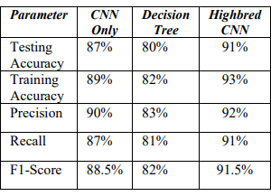

Slide 6
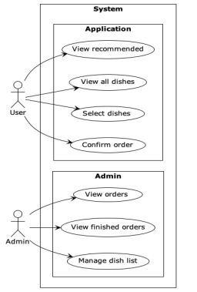
Article from Susanto et al. (2022)
Focus on system desgin

Slide 7

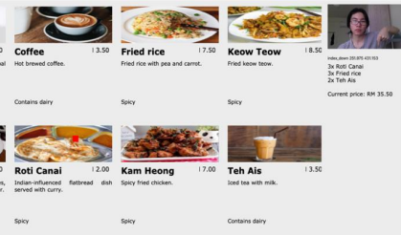
The majority of the front-end is menu
Camera and order list on the top right
Using our train model to classify user’s gestures

Slide 8
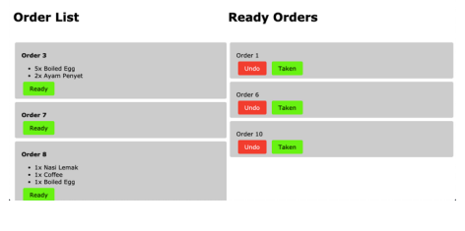
Staff can look at customers’ orders. They can click “Ready” if the food is finished. Click “Taken” if customer has taken their meal.

Slide 9
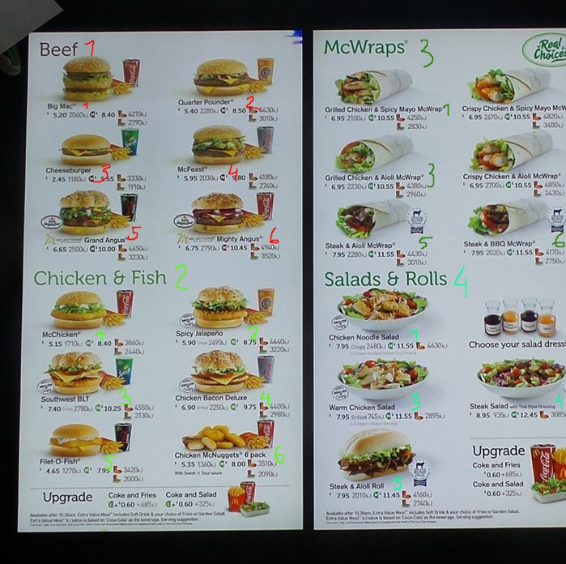
Proposed methodology
I plan to combine the two papers
The model training process follows paper 1 guide
Perhaps I could try to use CNN and ensemble methods instead of Decision Tree
I plan to store my data on the cloud and locally

Slide 10
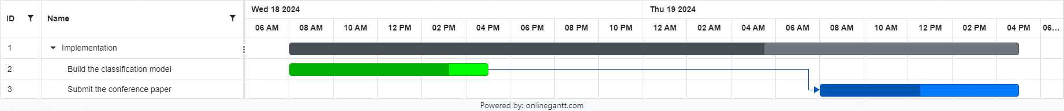
I cannot say for sure I can complete the full implementation listed on the report. I would really like to but due to tight deadline, I think the best I can do is to build a model to classify the gestures.

